Slide 1

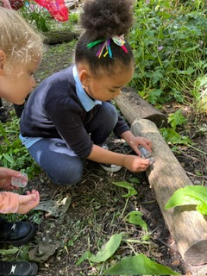
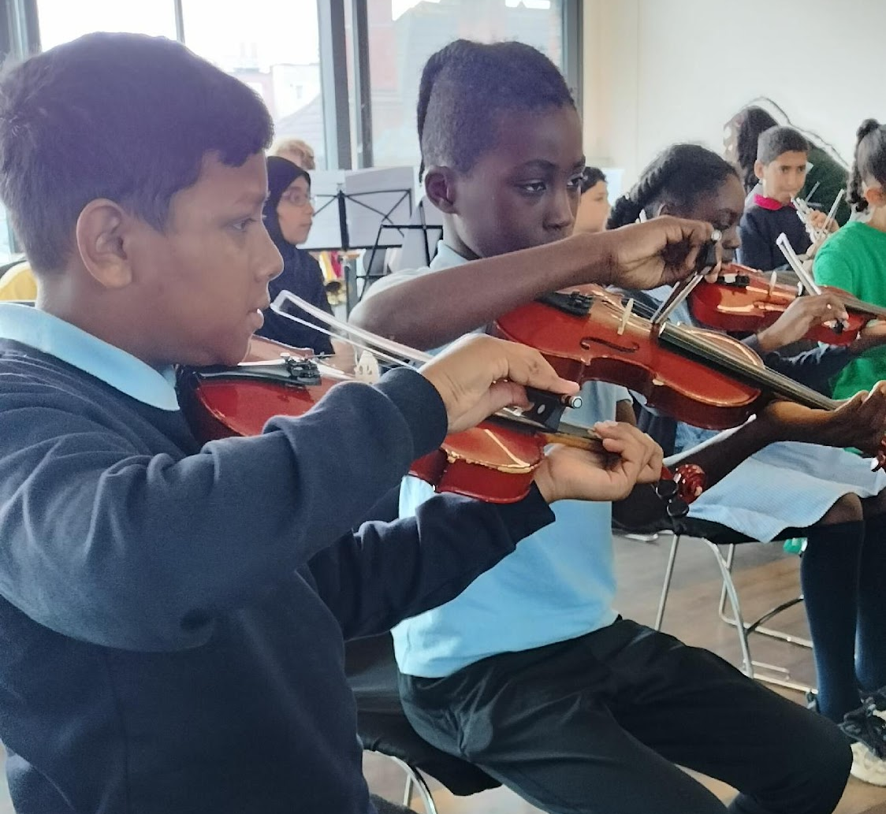
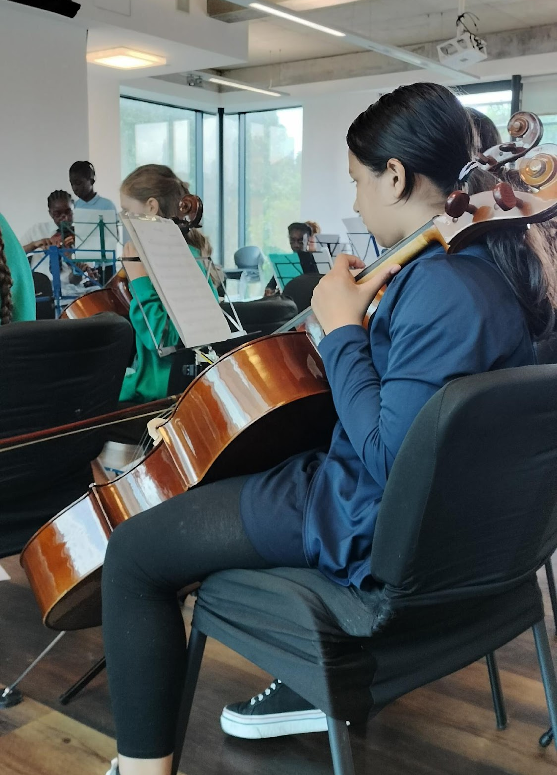
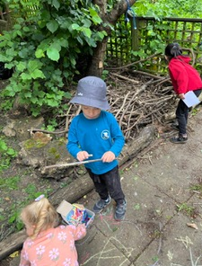
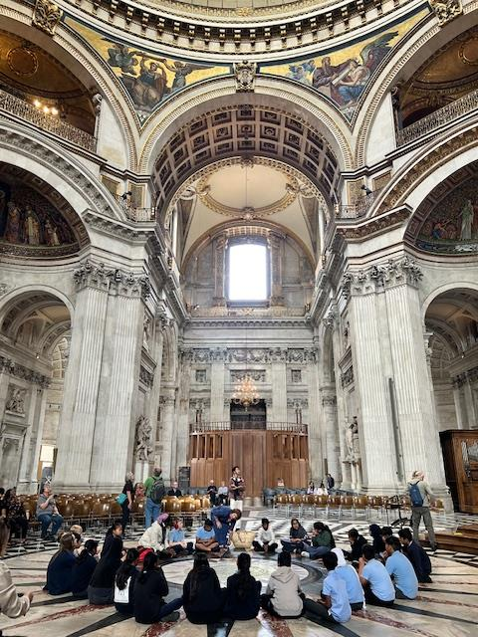
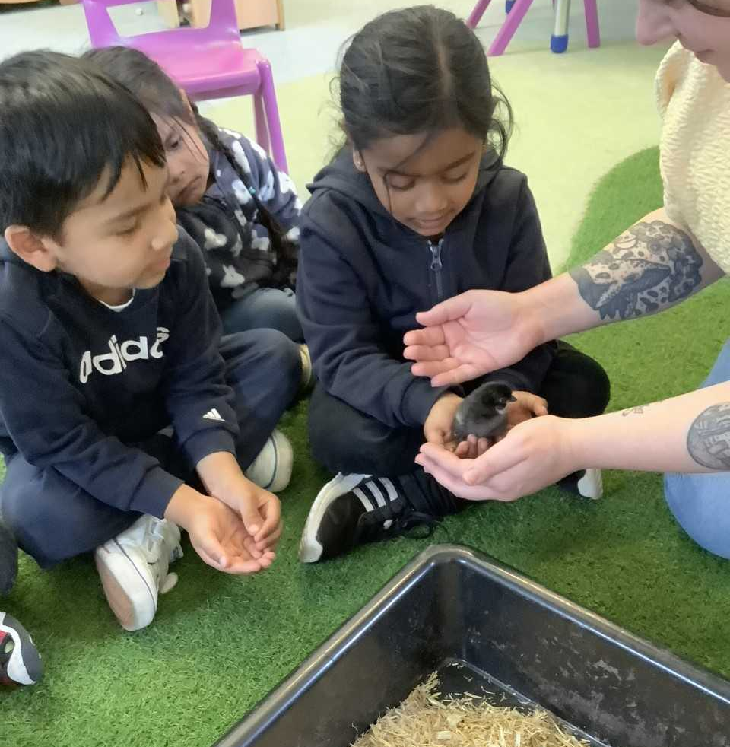
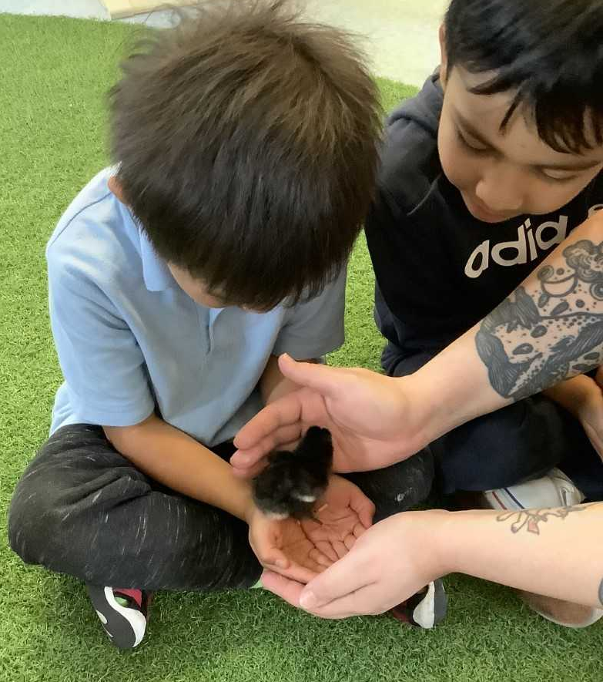
MALMESBURY PRIMARY SCHOOL
Newsletter: 7th June 2024
www.malmesburyschool.uk
admin@malmesbury.towerhamlets.sch.uk
Head Teacher: Claire Stewart
Tel: 020 8980 4299
@MalmesburyPri
Dear parents, carers,
We’ve had lots of exciting learning in school this week AND a high of 98% attendance on Thursday. It looks like our children have been practising for next week’s 100% attendance week! #pride
Our talented Y5’s practising for their performance with Tower Hamlets orchestra. #perseverance
Some of our reception children’s first forest school session as we get ready for our full launch in September! #curiosity
Our nursery children welcomed some new additions this week with the hatching of 7 fluffy chicks. Our children are doing a great job of learning how to look after them. #care
Year 6 visited St Paul’s cathedral to learn how it was protected during the Blitz in World War II #collaboration
BE THE BEST YOU CAN BE

Slide 2
Key dates for this half term…. full details to follow for individual events
Monday 10th June | KS1 phonics screening check week (Y1’s and some Y2’s) 100% Attendance Week
Tuesday 11th June | Y1 Queen Elizabeth Olympic park trip Y3 London Zoo trip
Wednesday 12th June | PTFA Eid bake sale and chai stall – thank you for your donations!
Monday 17th June | Eid holiday: School closed
Wednesday 19th June | Reception Maritime Museum trip
Thursday 20th June | Y1-Y6 sports day at Mile End Stadium. Parents welcome to join us from 12:15pm
Wednesday 26th June | Y2 Chalkwell beach trip EYFS sports day (nursery, reception) 9:15am – 10:30am
Wednesday 3rd July | 3:30pm Malmesbury PTFA summer fair Raffle tickets on sale before/after school from Monday 10th June
Thursday 4th July | General Election Polling Station: School closed to pupils *New EYFS families to our school in Sept 24 ‘stay and play’ sessions
Friday 5th July | Y3, Y4, Y5 Music Concert 2pm in Central Foundation School’s auditorium. Y6 Tower Hamlets Secondary School transfer day.
Monday 8th July | Reception Music Concerts: 9:15am and 2:30pm.
Tuesday 9th July | Y6 leavers’ trip: Southend Adventure Island
Wednesday 10th July | Nursery Victoria Park picnic trip Y1, Y2 Music Concerts: 9:15am and 2:30pm
Friday 12th July | Nursery Music Concert: 9:15am and 2:30pm Y6 Into-University transition day
Monday 15th July | Meet the new teacher session Annual reports home
Wednesday 17th July | 2pm Y6 Leavers’ Performance
Thursday 18th July | 3:30pm Y6 Leavers’ Party
Friday 19th July | 1:45pm End of term
Wednesday 4th September | First day of term for children

